Slide 1
COT5615: Math for Intelligent Systems I
Anand Rangarajan
Lecture 13

Slide 2
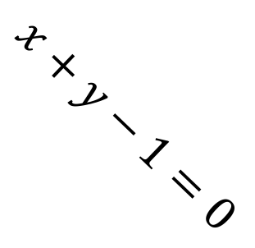
Linear Discriminator
$$x+y−1=0$$

Slide 3
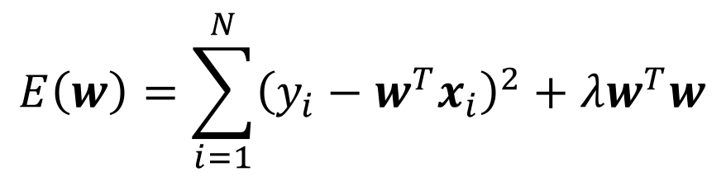
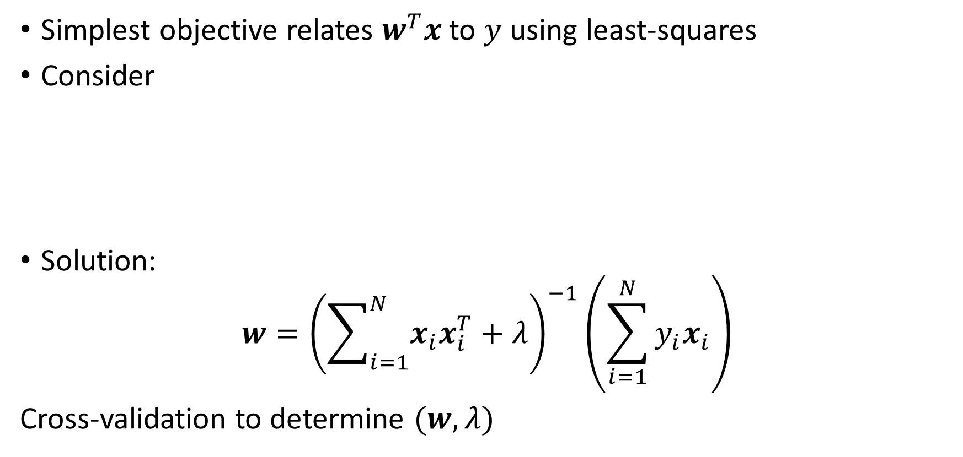
Linear Regression for Discrimination
Simplest objective relates $w^{T}x$ to $y$ using least-squares
Consider
Solution:
$$w={\left(\sum_{i=1}^{N}{x_{i}x_{i}^{T}}+λ\right)}^{−1}\left(\sum_{i=1}^{N}{y_{i}x_{i}}\right)$$
Cross-validation to determine $(w,λ)$
$$E\left(w\right)=\sum_{i=1}^{N}{{\left(y_{i}−w^{T}x_{i}\right)}^{2}}+λw^{T}w$$

Slide 4
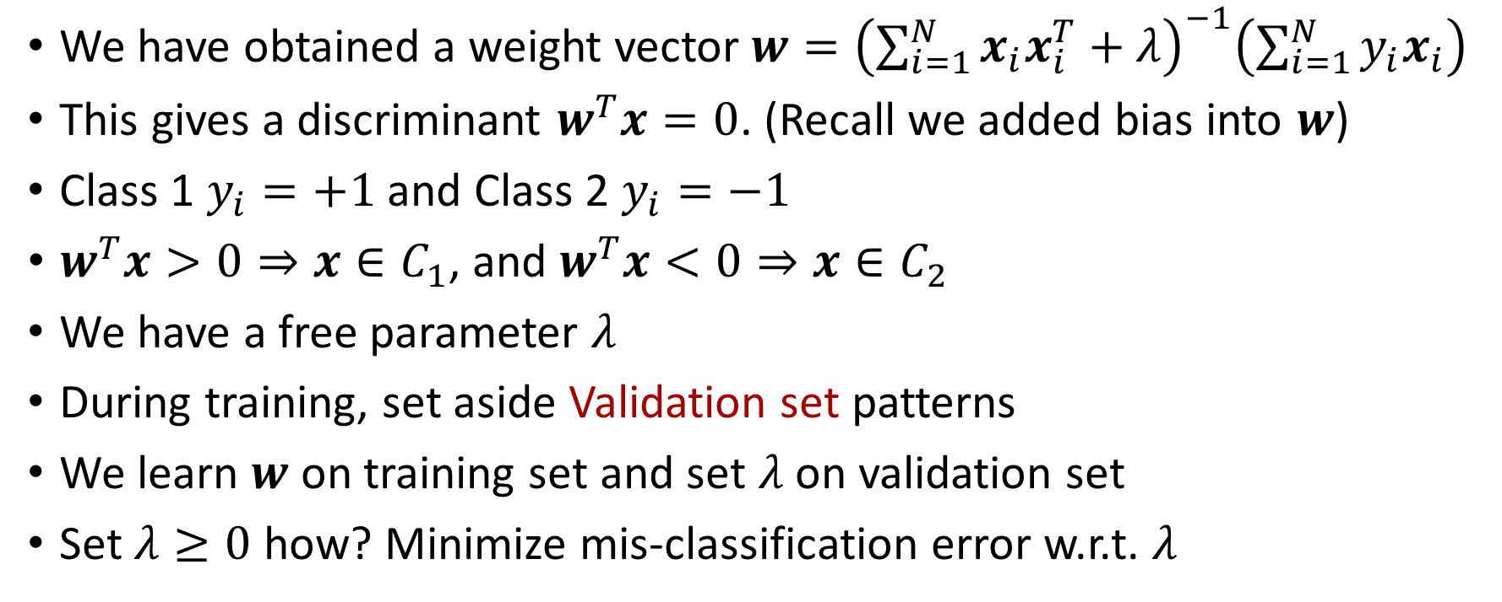
Training
We have obtained a weight vector$w={\left(\sum_{i=1}^{N}{x_{i}x_{i}^{T}}+λ\right)}^{−1}\left(\sum_{i=1}^{N}{y_{i}x_{i}}\right)$
This gives a discriminant $w^{T}x=0$. (Recall we added bias into $w$)
Class 1 $y_{i}=+1$ and Class 2 $y_{i}=−1$
$w^{T}x>0⇒x∈C_{1}$, and $w^{T}x<0⇒x∈C_{2}$
We have a free parameter $λ$
During training, set aside Validation set patterns
We learn $w$ on training set and set $λ$ on validation set
Set $λ≥0$ how? Minimize mis-classification error w.r.t. $λ$

Slide 5
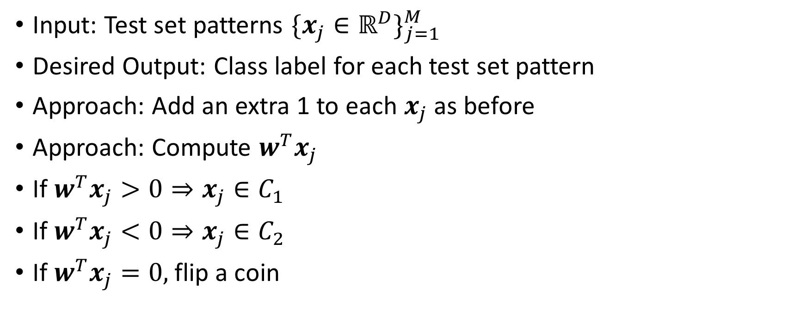
Testing
Input: Test set patterns $\{x_{j}∈ℝ^{D}\}_{j=1}^{M}$
Desired Output: Class label for each test set pattern
Approach: Add an extra 1 to each $x_{j}$ as before
Approach: Compute $w^{T}x_{j}$
If $w^{T}x_{j}>0⇒x_{j}∈C_{1}$
If $w^{T}x_{j}<0⇒x_{j}∈C_{2}$
If $w^{T}x_{j}=0,$ flip a coin

Slide 6
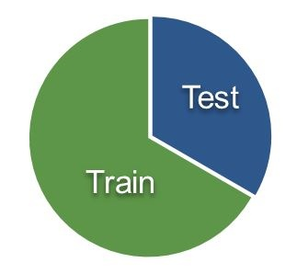
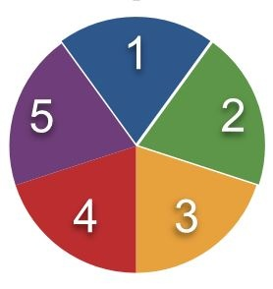
Cross-Validation
No cross-validation
Ordinary cross-validation
Dataset divided into training and testing.
No way to set hyperparameters.
Machine should not see test set labels.
Dataset divided into training/cross-validation/testing.
K-fold cross-validation (6 above).
Nested cross-validation?
Machine should not see test set labels.

Slide 7

Linear Discriminant Example
40 2D patterns for training, 10 patterns for testing
25 patterns from class 1 and same from class 2
No validation set
$λ$ set to 0.001 arbitrarily

Slide 8
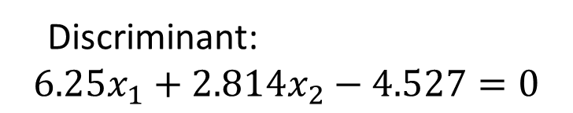
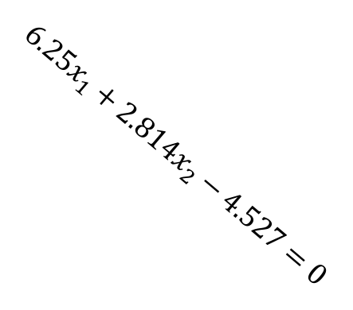
Linear Discriminant Example
Discriminant:
$$6.25x_{1}+2.814x_{2}−4.527=0$$
$$6.25x_{1}+2.814x_{2}−4.527=0$$

Slide 9
Linear Discriminant Code
load x;
% 1-25 are class 1 and 26-50 are class 2
% 1-20 from class 1 and 26-45 from class 2 used for training
% 21-25 from class 1 and 46-50 from class 2 used for testing
% No validation: lambda set to 0.001 arbitrarily
figure(1)
plot(x1(1:20),x2(1:20),'o')
hold on
plot(x1(26:45),x2(26:45),'x')
plot(x1(21:25),x2(21:25),'b*')
plot(x1(46:50),x2(46:50),'rd')

Slide 10
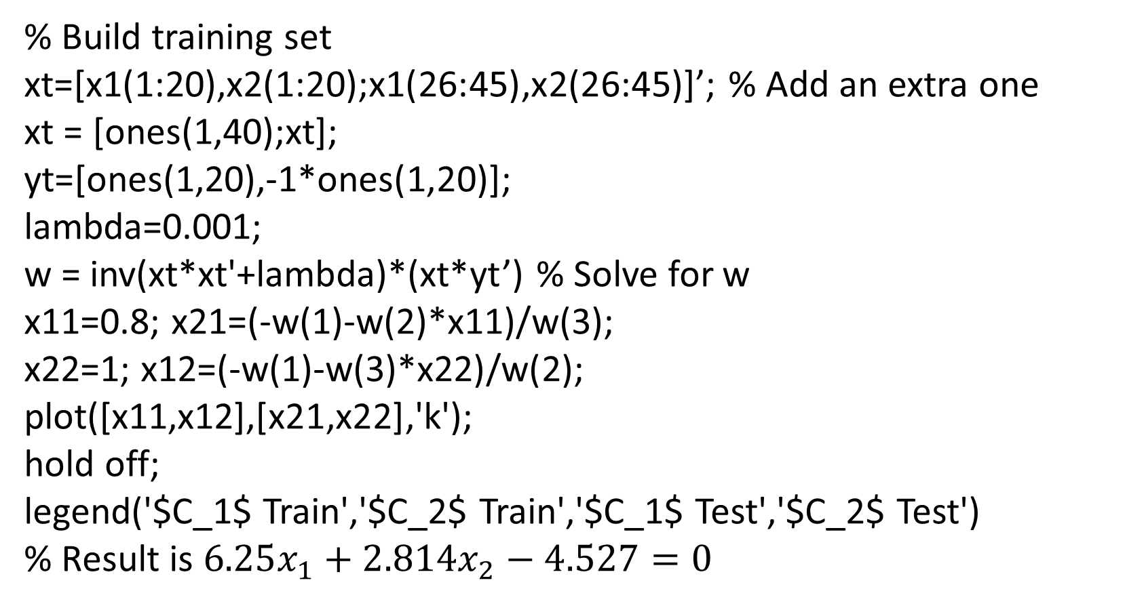
Linear Discriminant (contd.)
% Build training set
xt=[x1(1:20),x2(1:20);x1(26:45),x2(26:45)]’; % Add an extra one
xt = [ones(1,40);xt];
yt=[ones(1,20),-1*ones(1,20)];
lambda=0.001;
w = inv(xt*xt'+lambda)*(xt*yt’) % Solve for w
x11=0.8; x21=(-w(1)-w(2)*x11)/w(3);
x22=1; x12=(-w(1)-w(3)*x22)/w(2);
plot([x11,x12],[x21,x22],'k');
hold off;
legend('$C_1$ Train','$C_2$ Train','$C_1$ Test','$C_2$ Test')
% Result is $6.25x_{1}+2.814x_{2}−4.527=0$

Slide 11
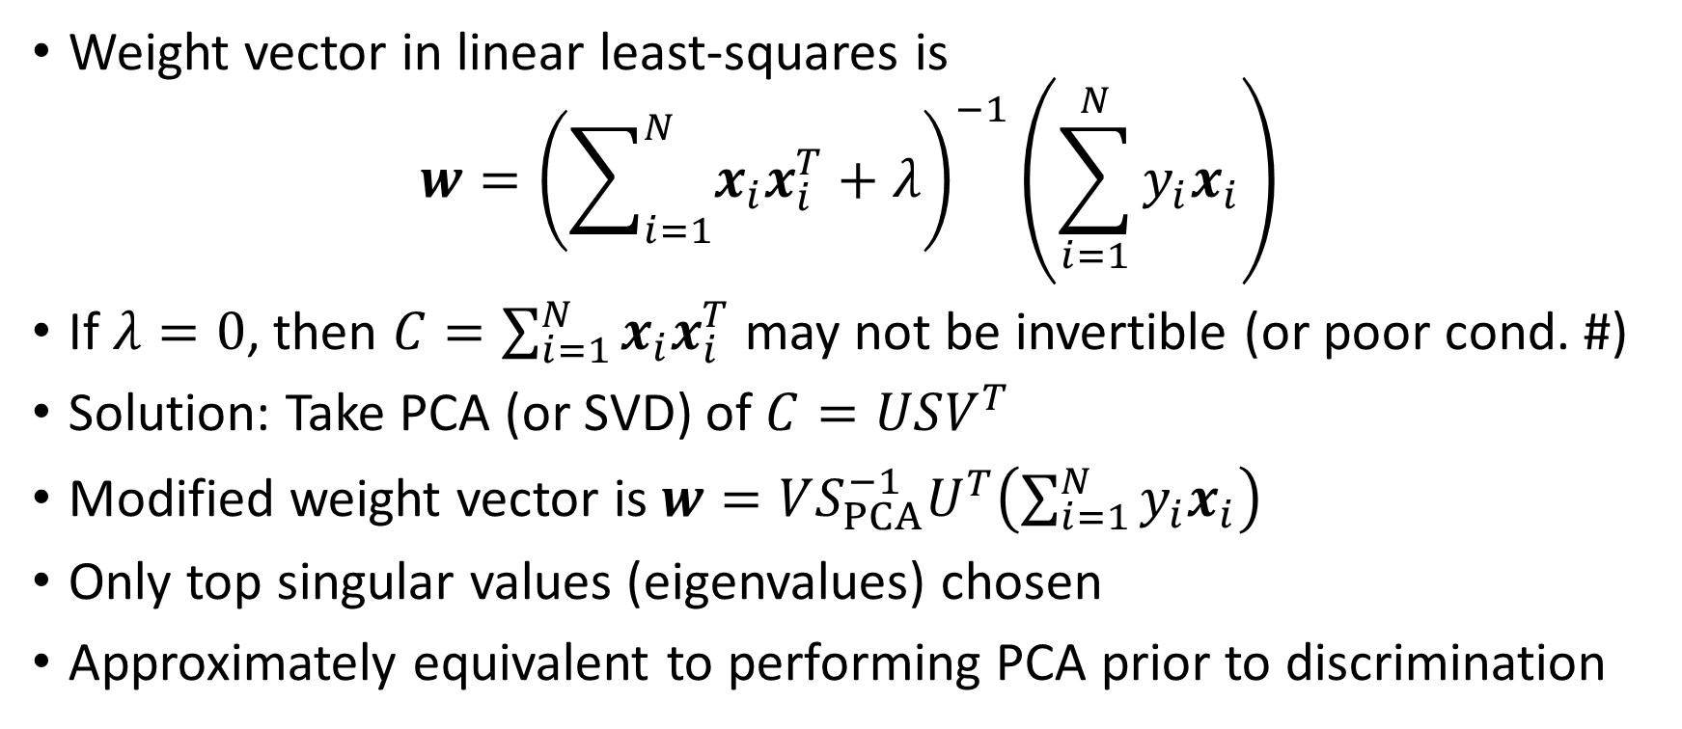
Linear Discriminants and SVD
Weight vector in linear least-squares is
$$w={\left(\sum_{i=1}^{N}{x_{i}x_{i}^{T}}+λ\right)}^{−1}\left(\sum_{i=1}^{N}{y_{i}x_{i}}\right)$$
If $λ=0$, then $C=\sum_{i=1}^{N}{x_{i}x_{i}^{T}}$ may not be invertible (or poor cond. #)
Solution: Take PCA (or SVD) of $C=USV^{T}$
Modified weight vector is $w=VS_{PCA}^{−1}U^{T}\left(\sum_{i=1}^{N}{y_{i}x_{i}}\right)$
Only top singular values (eigenvalues) chosen
Approximately equivalent to performing PCA prior to discrimination

Slide 12
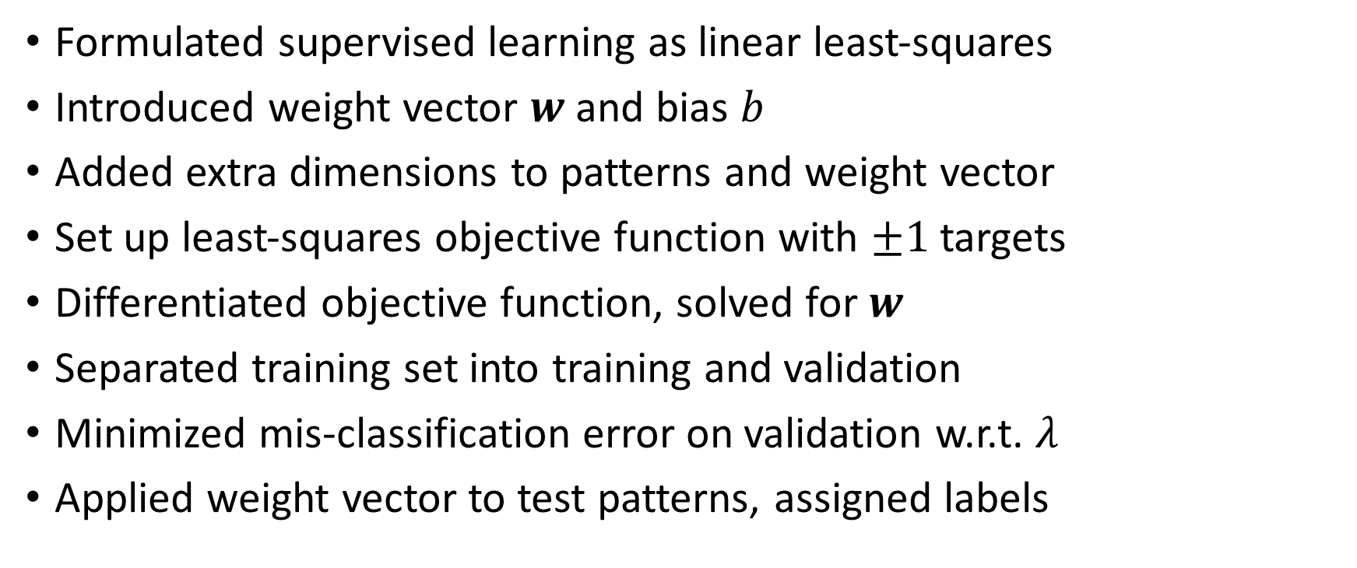
Conclusions
Formulated supervised learning as linear least-squares
Introduced weight vector $w$ and bias $b$
Added extra dimensions to patterns and weight vector
Set up least-squares objective function with $±1$ targets
Differentiated objective function, solved for $w$
Separated training set into training and validation
Minimized mis-classification error on validation w.r.t. $λ$
Applied weight vector to test patterns, assigned labels

